Slide 1




Lumen
Home
About
Contact
Lumen Protocol
The data layer for Intelligent AI
Start
www.lumen.onl

Slide 2

Lumen
Home
About
Contact
AI is Hitting a Wall.
The race for AI dominance is bottlenecked by a simple, critical fact: the quality of training data is collapsing.
Noisy & Unreliable: Public data from sources like GitHub is filled with low-quality tutorials, boilerplate, and insecure code.
Legally Risky: Training on scraped code without explicit consent is a copyright and IP ticking time bomb.
The Real Value is Trapped: The world's most valuable dataset—billions of lines of proprietary, human-written logic—is locked away in private repositories, generating zero value.

Slide 3


Lumen
Home
About
Contact
A Secure Pipeline for the World's Most Valuable Data.
Lumen is a decentralized protocol that creates a fair, secure, and transparent market for proprietary source code.
For AI Companies:
API access to a growing, ethically-sourced dataset of high-signal, human-written code to build a true competitive advantage.
For Developers:
A simple CLI to monetize their existing work. Securely. Anonymously. Effortlessly.

Slide 4
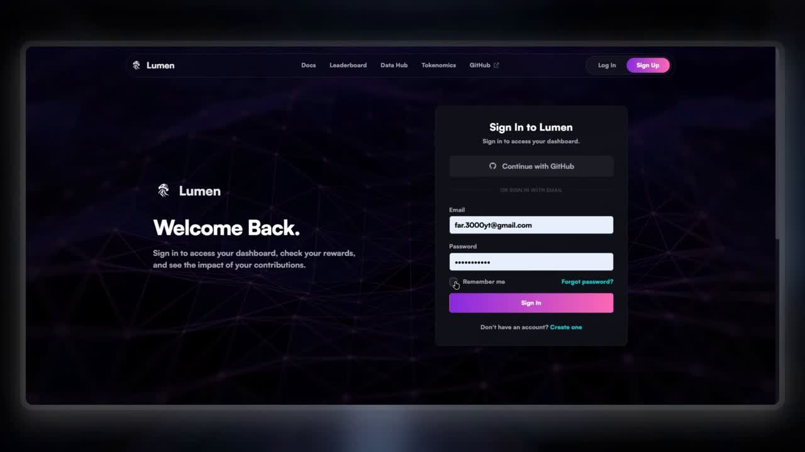
Lumen
Home
About
Contact
A Fully Functional Contributor Platform.
We haven't just designed a solution; we've built the engine. Our MVP is live and ready for launch.
1. The Secure CLI & Local-First Anonymization:
Developers use our open-source CLI to contribute. All sanitization and secret-scrubbing happens on their machine. Raw code never leaves their control.
2. The Contributor Dashboard & Wallet:
A complete web application for users to track their contribution history, see detailed valuation reports, and manage their $LUM rewards on the Solana network.

Slide 5




Lumen
Home
About
Contact
We Don't Just Collect Data. We Price It.
Our competitive advantage is our hybrid valuation engine that intelligently appraises every contribution.
Uniqueness Check
Quantitative Metrics
Code is converted into a semantic "fingerprint" and cross-referenced against our internal network to prevent duplication and reward only novel work.
We analyze complexity, token count, and structure for an objective baseline.
AI Qualitative Analysis
Fair Reward Calculation
We leverage Google's Gemini models to score the code's architectural quality and project clarity, just like a senior engineer would.
The final $LUM reward is a transparent synthesis of these factors, ensuring quality is rewarded over quantity.

Slide 6
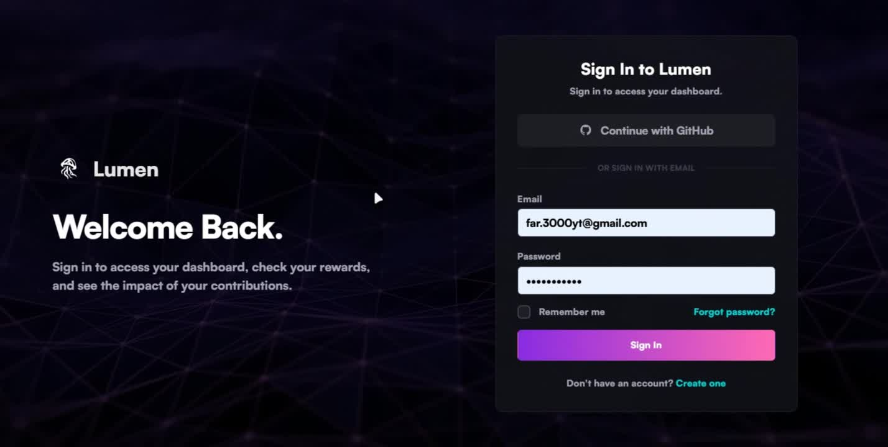
Lumen
Home
About
Contact
The contributor experience.
Here is a demo of the contributor experience, how the code goes from your PC to our database, and how the user gets rewarded live for it.

Slide 7
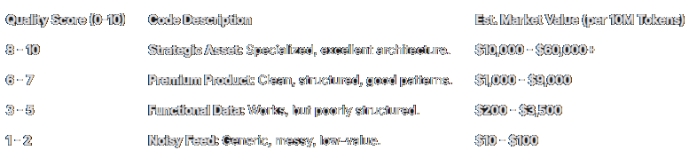
Lumen
Home
About
Contact
Not all data is created equal.
We are a boutique, not a factory.
Our research shows a massive value gap between raw, scraped data and curated, high-quality datasets. Our valuation engine allows us to be the premier supplier of the latter.
Our Business Model: Boutique Curation. By focusing only on quality scores of 6+, we solve the "Payout Paradox." We can afford to pay contributors fairly (0−10−100+ per project) because we sell a premium, high-value product, not a low-grade commodity.

Slide 8

Lumen
Home
About
Contact
How We Turn Capital into a Moat.
Our model uses this funding round to solve the "cold start" problem and create an invaluable, proprietary asset. It's a simple, three-step engine.
Deploy Capital as Rewards
Drive Enterprise Revenue
We use your investment to directly fund the reward pool. This solves the "chicken-and-egg" problem by creating a powerful incentive for the world's best developers to contribute their high-quality data from day one.
The unique value of this asset allows us to secure enterprise contracts. This revenue is then used to fund the next cycle of rewards, making the entire model self-sustaining.
Create a Proprietary Asset
This targeted incentive creates our core asset: an ethically-sourced, high-signal dataset of human-written code that is not available anywhere else. This dataset is our defensible moat.

Slide 9

Liceria
Home
About
Contact
A Phased Plan for Market Entry.
We have the product and a clear plan to activate our Value Creation Engine.
Launch Plan (Next 3 Months):
Genesis Contributor Program: Launch the beta to onboard the first 500 developers, deploying the initial reward pool and building our foundational dataset.
Secure Strategic Launch Partners: We are in discussions with established developer communities and platforms to ensure a successful launch and immediate, high-quality supply.
Secure First Data Partnerships: Convert our pipeline of interested AI companies into our first 3 signed Letters of Intent (LOIs), validating the demand for our asset.

Slide 10
Lumen
Home
About
Contact
The Vision: The Data Marketplace & Beyond
This funding allows us to build our commercial engine and transition from a founder-led project to a scalable company.
The Marketplace Vision:
A dedicated portal (business.lumen.onl) where data consumers can:
Access Data via a Secure API: With managed, revocable API keys.
Use Granular Filtering: Create custom datasets by language, quality score, complexity, and more.
Leverage Semantic Search: Use keywords to search our AI-generated summaries to find code that solves specific problems.
Scaling the Company:
This is currently a founder-led team. To execute on our vision and scale effectively, this investment will allow us to hire key personnel to professionalize our core business functions:
Product & Engineering: Accelerate the development of the marketplace and ensure our infrastructure is enterprise-ready.
Business Development & Sales: Build relationships, convert our LOI pipeline into contracts, and drive revenue.
Marketing & Brand: Establish Lumen as the definitive, trusted brand in the AI data space and drive developer adoption.

Slide 11

Lumen
Home
About
Contact
The Ask
We are raising $500,000 in a pre-seed round to activate our data economy and build the world's premier source for AI training data.
This provides an 18-month runway to achieve:
Launch Marketplace MVP: Go live with business.lumen.onl.
Onboard 1,000+ Developers: Successfully complete the Genesis Program.
Convert LOIs to Contracts: Turn our initial partnerships into recurring revenue.
Hire Core Team: Bring on our first engineering and business development hires.

Slide 12
Lumen
Home
About
Contact
Thank You
End
www.lumen.onl

